Slide 1
Ohio FFA Evaluation Kick Off
Ohio FFA State Staff
October 22, 2025
Notes:
Good afternoon all! It was really good to see some of you last week at National FFA Convention. I also appreciate you all joining us this afternoon to kick off another evaluation year. Last week we had the opportunity to highlight several of our students and programs on the National Stage and it is ready to start thinking about the process of identifying the next round of finalists. My name is Alyssa Bregel and I am an assistant director in the office of career tech and serve as the Ohio FFA State Advisor.

Slide 2

Agenda & Topics
Welcome and Overview
Pre-Evaluation
Officer Books

Slide 3
State Evaluation Timeline
February 2nd 6:00 pm – ALL Applications DUE
ALL State Degrees, Star State Degrees, American Degrees, Star American Degrees, and Proficiency Awards must be submitted in the State Application Manager from ALL districts for State Evaluation.
February 10th and 11th – In-person State Evaluation at the FFA Center
Feb 10 – even district teachers
Feb 11 – odd districts teachers
ALL State and American Degrees
Need teachers to volunteer
Will use AET platform for evaluation
February 12th and February 13th – In-Person Proficiency and Star Degree Evaluation at the FFA Center
Need teachers to volunteer
Will use AET Platform for evaluation

Slide 4
State Evaluation Timeline
February 20th – Teacher access to applications
Degrees with an “R” status will need to be re-submitted incurring a $35 fee (if choosing to fix)
Degrees with an “A” status are approved
Degrees with a “DQ” are not fixable and need to reapply the following year
February 26th – Final Degree Submit 6:00 pm
All degrees with an “R” status must be re-submitted using the Application Manager
Will incur a $35 fee if submitted
February 27th through March 9th
State Staff and a Governance Committee member will re-evaluate applications to ensure degrees have been fixed per comments

Slide 5
State Evaluation Timeline
March 2nd – National Chapter Application DUE 6:00 pm
Parts I and II must be submitted using the State Application Manager for evaluation
March 5th through March 9th 6:00 pm – National Chapter Evaluation
Will occur virtually utilizing the AET platform
Need 30 teachers to volunteer to participate
March 6th – Agriscience Fair Reports DUE 6:00 pm
Must be submitted in the State Application Manager

Slide 6
State Evaluation Timeline
March 19th – Top 4 Proficiency and Star Interviews
Top 4 Proficiency and Top 4 Star State Interviews will occur virtually via Zoom
March 24th, 25th, 26th, – National Chapter Interviews
Top 10 Premier National Chapter Interviews will occur virtually via Zoom
March 31st , April 1st and April 2nd– Agriscience Fair Interviews
Agriscience Fair Interviews will occur virtually via Zoom

Slide 7
Pre-Evaluation
Each District may conduct a pre-evaluation
County, sub-district, district, peer evaluation
Purpose is to focus on records utilizing the electronic check for record books
2019-2026 State Degree Minimum Standards
2026 State Degree Record Review Sheet
2026 Ohio American Degree Record Review Sheet
Other options can be utilized as districts see fit
Districts are responsible for securing teachers for their peer-evaluations process
Pair teachers together that promote growth with the process
No application is prevented from being submitted on February 2nd
Applications with concerning SAE’s can be shared with Alyssa Bregel or Brenda Correll

Slide 8
Pre-Evaluation
All State and American degrees need to be submitted in the State Submission list by February 2nd, 6:00 PM for State Evaluation.
Complete “MET” applications
Submit on time
Applications have access to interactive records (locked or uploaded in the Google Form)
*Do NOT wait until the last minute to submit
Proficiency applications are competitive and not recommended for Pre-Evaluations.

Slide 9
Electronic Signatures
Electronic Signature Page – 1 time process
Student
Parent
Advisor – must be logged into AET to sign
Guidance Counselor
Signatures on Plan Tab are NOT required for evaluation

Slide 10
Evaluation
Evaluators should use the State Degree or American Degree Check Sheet:
2019-2026 State Degree Minimum Standards
2026 State Degree Record Review Sheet
2026 Ohio American Degree Record Review Sheet
Evaluate the entire set of records
If the records have concerns for corrections – provide positive, professional feedback for the student to make the needed records
May be helpful to lead with the concern (SAE, Activities, Community Service, etc.)

Slide 11
Evaluation
Use the interactive record book to evaluate the records.
Review Sheet is meant to serve as an evaluation tool to assist with the process.
What is not on the review sheet is included in the electronic check.
Application is a separate link from the record books
Capture feedback on electronic sticky note

Slide 12
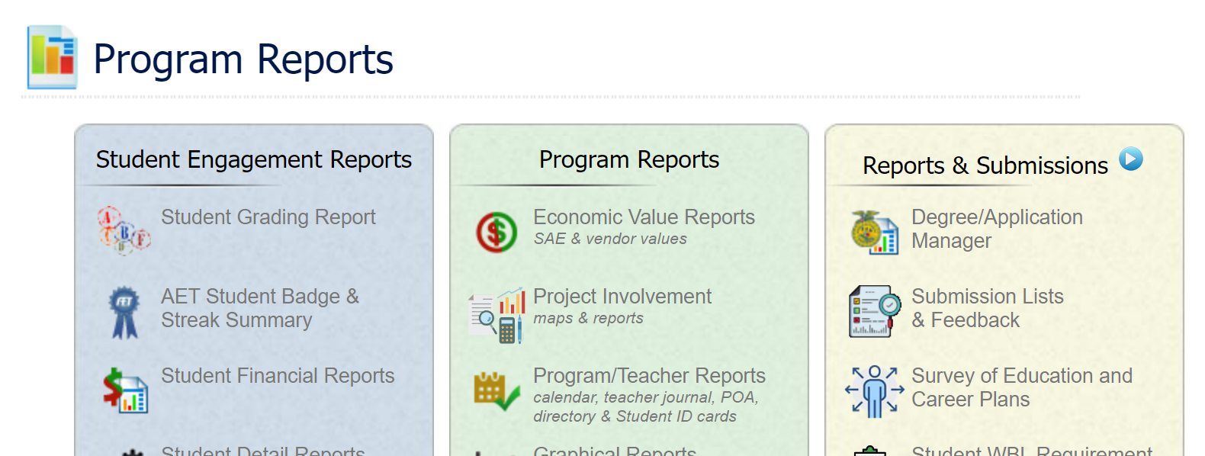
How to submit an application
Application must have “0” Not Mets
Teachers will use the AET Awards and Degree Application Manager

Slide 13
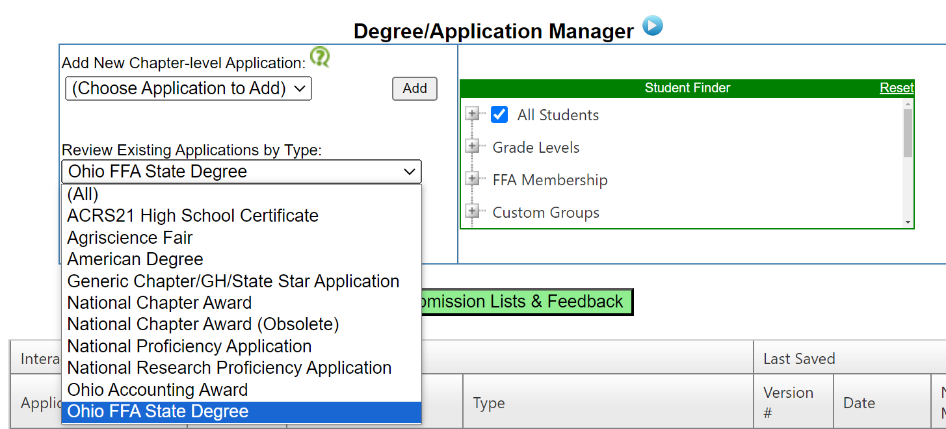
How to submit an application
Choose Application Type

Slide 14
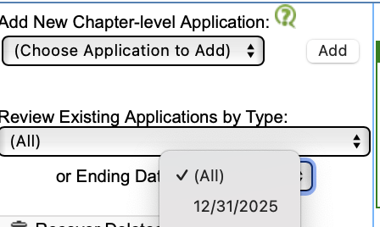
How to submit an application
Select ending date of application (12/31/2025)

Slide 15
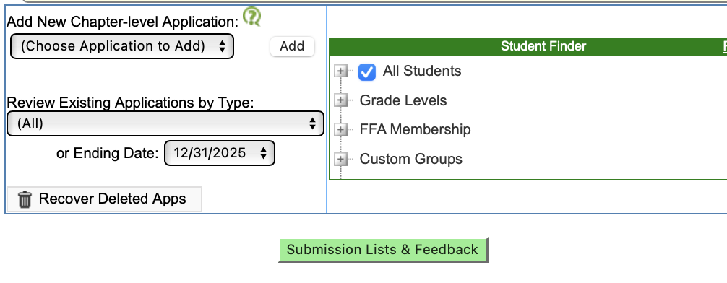
How to submit an application
Click “Submission List and Feedback

Slide 16
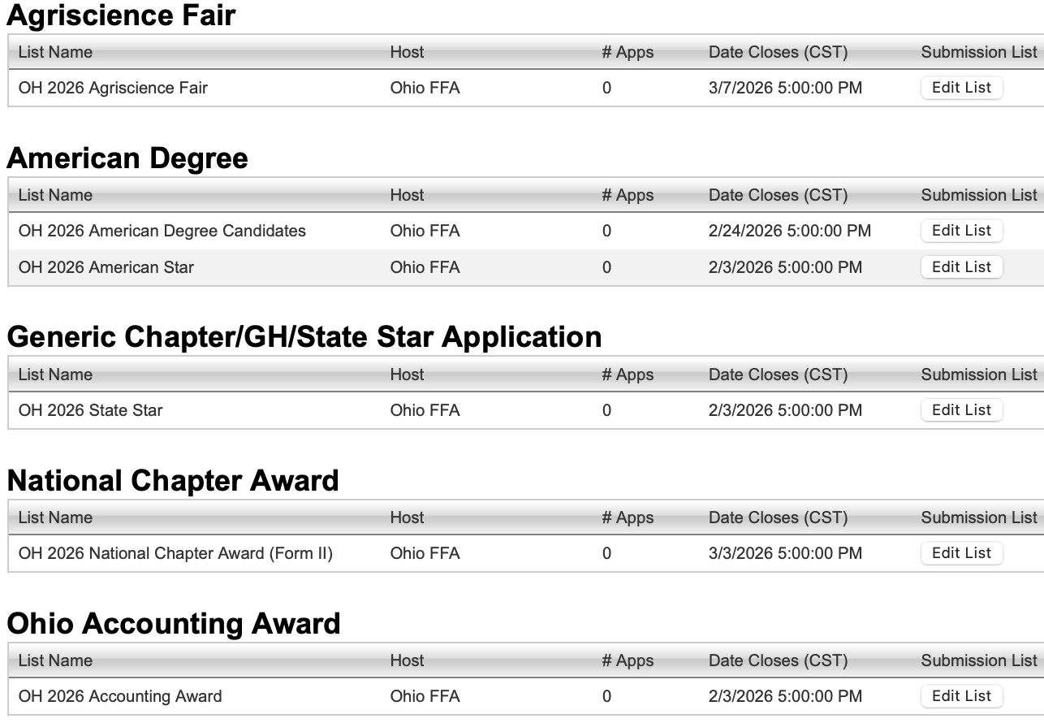
How to submit an application
Click “Edit” under the application type you are submitting

Slide 17
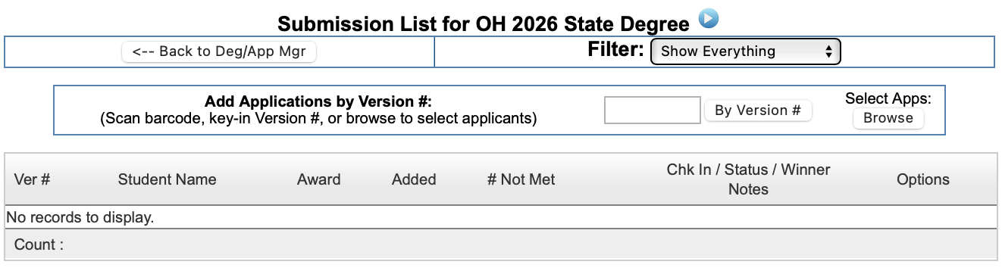
How to submit an application
Click Browse

Slide 18
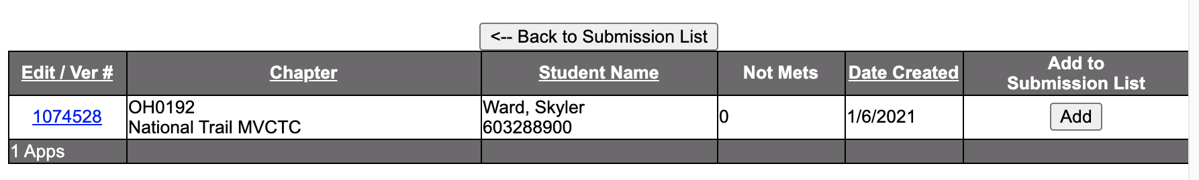
How to submit an application
Click Add

Slide 19
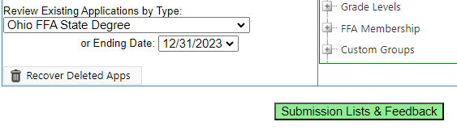
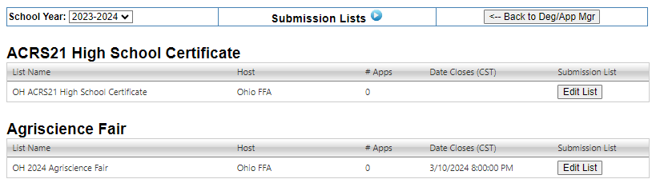
Did I submit?
Click Submission Lists and Feedback
Select the appropriate app and application year and view Edit List

Slide 20
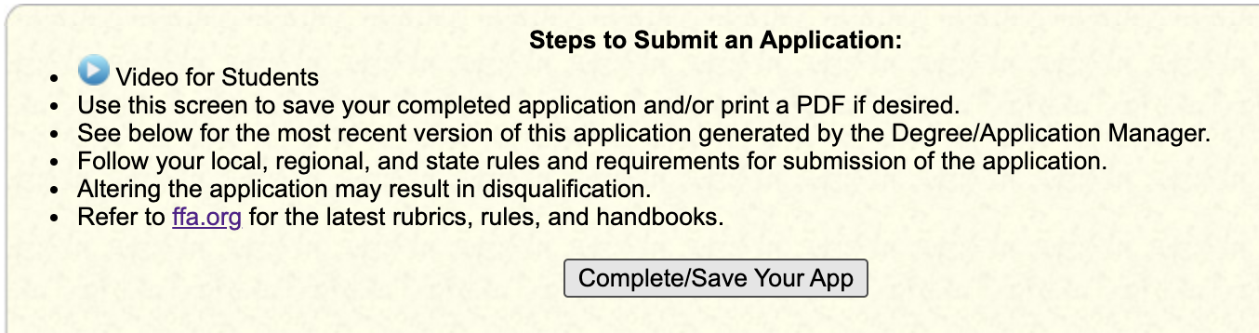
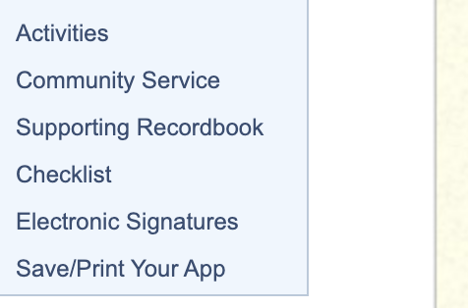
How do I resubmit?
Read feedback on the sticky note and complete corrections in the records
Record corrections will change both the application and interactive records when locked
A new version must be created in the student app – Choose Save/Print app in the application

Slide 21
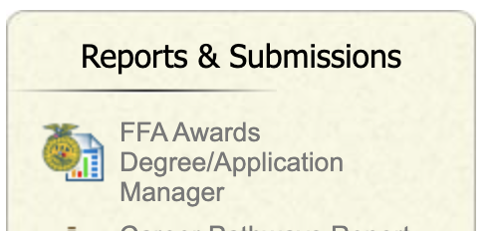
How do I resubmit?
Return to Awards and Application Manager
Repeat the submission steps mentioned previously
Notes:
Do NOT add a New State Degree Application
-Edits in the records are LOCKED to the already existing application
The New Version # will be HIGHER than previous Versions submitted
It will only give you the most recent Version that has 0 “Not Mets” when submitting
Apps that have not been Returned, most likely earned A with no edits recommended
Teachers may remove an application rated A to make edits following any level of evaluation,
but this then will require the new version and a re-submission in the State Submission List

Slide 22
Tips
Review:
2026 Evaluation Letter
The Agriculture Education (FFA) – 4-H Memorandum of Understanding
Activity Cut-Off – December 31, 2025
All events should have journal reflections

Slide 23
Non AET Records
Non-AET Records need to be uploaded using this link:
https://forms.gle/D85qUFZWvNM7HnVB6

Slide 24
Officer Books
Each District will be responsible for conducting officer book evaluations during their pre-evaluations and must use the scoring rubrics found on the Ohio FFA website.
ALL District Officer Book results (officer book, student name, student ID#, school name, score and rating) must be submitted from the district chair to Brenda Correll by February 20th

Slide 25
2026 Evaluation Year Changes for Agriscience Fair
For the 2026 evaluation year, (2025-2026 school year), FFA Chapters may only submit two Agriscience Award applications per division/category.

Slide 26
Honorary State/American Degree
Applications can be found on the Ohio FFA website.
Teachers of Agriculture
Anyone else other than a teacher
DUE February 22
Applications for an Honorary American FFA Degree can be submitted through the National FFA Website.
DUE June 1

Slide 27
Who to Contact
SAE, Community Service, Degree, Proficiency, and other related Questions – Alyssa Bregel or Matt Winkle
AET and General Record Keeping – Alyssa Bregel, Brenda Correll, and Travis Snyder
General Evaluation Questions, Membership and AET Transfers – Brenda Correll
Agriscience Fair – Alyssa Bregel
National Chapter – Alyssa Bregel
Officer Books – District Chair

Slide 28
Questions

